Slide 1






2ND CASE :
IAM

Slide 2
MY NAME:
SANJAY RENGASAMY THAMBU

Slide 3
WHAT IS IAM?
IAM (Identity and Access Management)
IAM is an AWS service that controls who can access AWS resources and what actions they can perform.
  Manages authentication (who you are)
  Manages authorization (what you can do)

Slide 4
WHAT IS USER AND USER GROUP?
IAM User
An IAM User represents a person or application that needs access to AWS.
  Has login credentials (password / access keys)
IAM User Group
An IAM User Group is a collection of IAM users that share the same permissions.
  Permissions are attached to the group, not individually to users
  Makes permission management easy and scalable

Slide 5
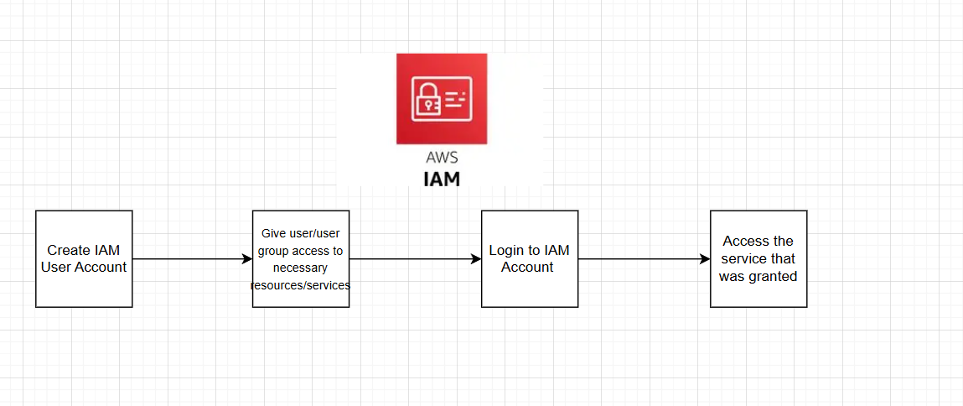
WORKFLOW ARCHITECTURE

Slide 6
SCREENSHOTS OF DEMO

Slide 7
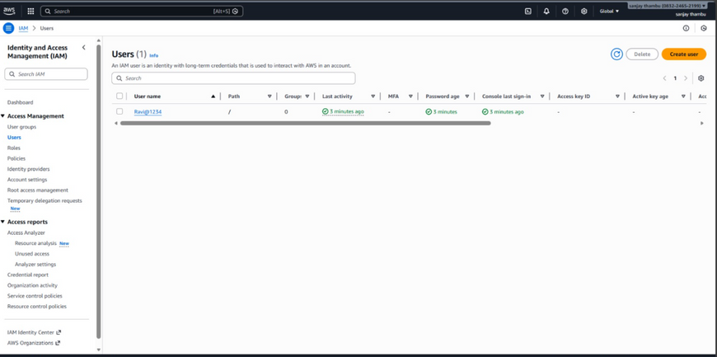
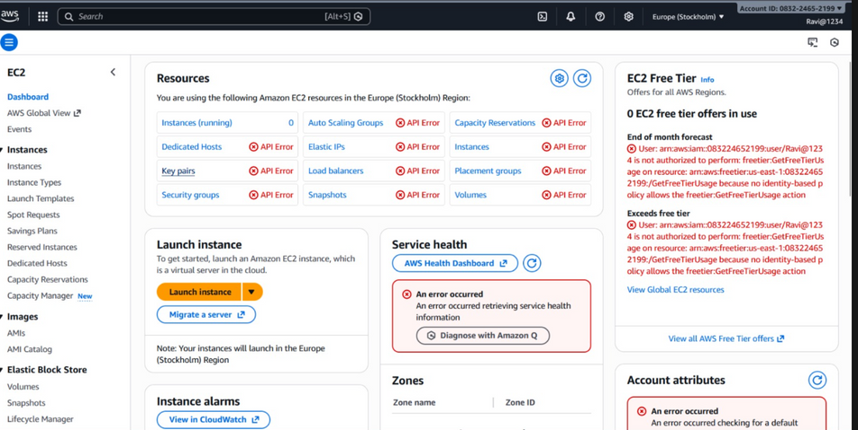
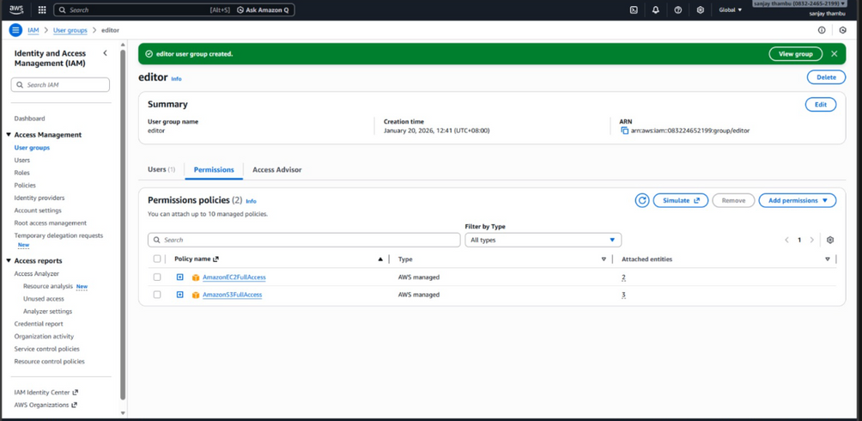
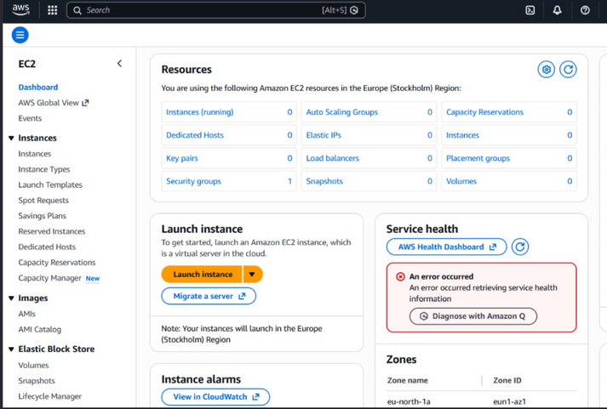
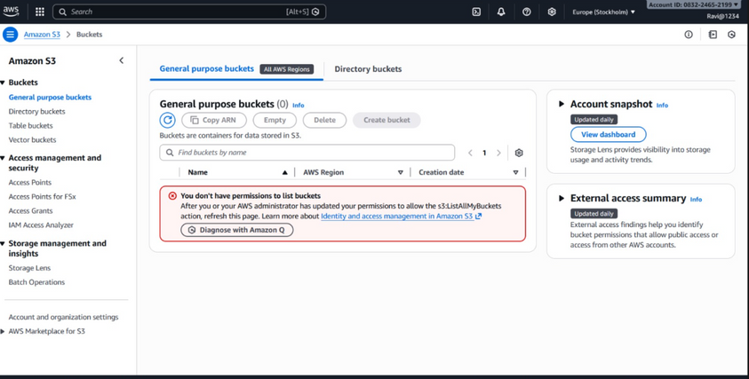
1) IAM ACCOUNT CREATED
3) NO ACCESS FOR EC2
4) Access granted and ready to use EC2 in IAM Account
2) NO ACESS GIVEN TO S3
5) ACCESS GIVEN TO SERVICES

Slide 8
THANK
YOU

